Slide 1
Computer Performance
For individual computers: Response time or Execution time = Time at the completion of a task – Time at the start of the task
At an overall level: Throughput or Bandwidth = Total amount of work done in a given time
Scenario 1: Replace a processor in a computer with a faster processor
Impact: Both response time and throughput will improve
Scenario 2: Add multiple processors so as to handle multiple tasks
Impact: In general, both response time and throughput will improve

Slide 2
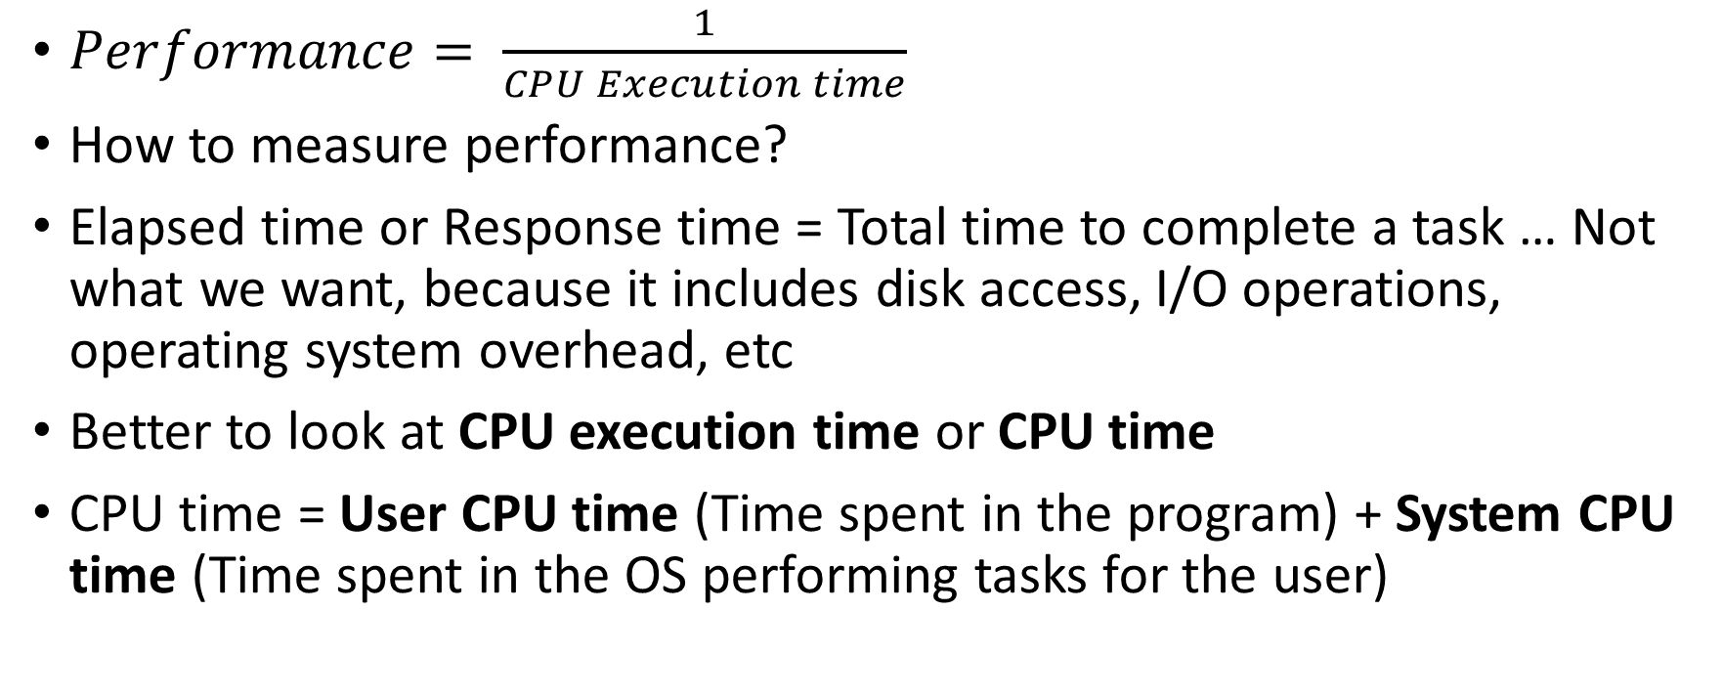
Computer Performance
$Performance= \frac{1}{CPU Execution time}$
How to measure performance?
Elapsed time or Response time = Total time to complete a task … Not what we want, because it includes disk access, I/O operations, operating system overhead, etc
Better to look at CPU execution time or CPU time
CPU time = User CPU time (Time spent in the program) + System CPU time (Time spent in the OS performing tasks for the user)

Slide 3
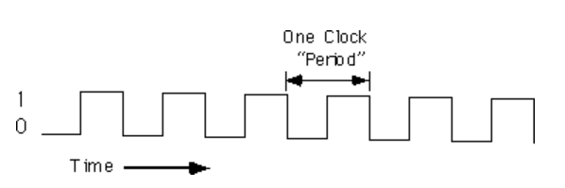
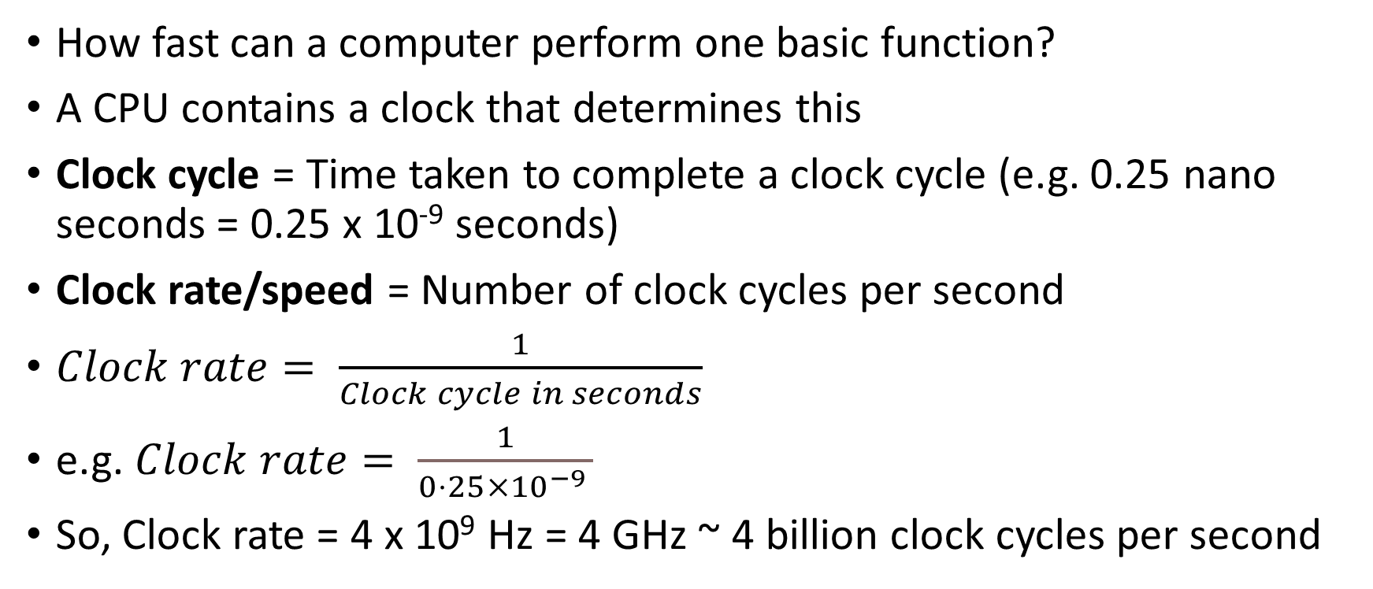
Clock Cycle
How fast can a computer perform one basic function?
A CPU contains a clock that determines this
Clock cycle = Time taken to complete a clock cycle (e.g. 0.25 nano seconds = 0.25 x 10⁻⁹ seconds)
Clock rate/speed = Number of clock cycles per second
$Clock rate= \frac{1}{Clock cycle in seconds}$
e.g. $Clock rate= \frac{1}{0⋅25×{10}^{−9 }}$
So, Clock rate = 4 x 10⁹ Hz = 4 GHz ~ 4 billion clock cycles per second

Slide 4
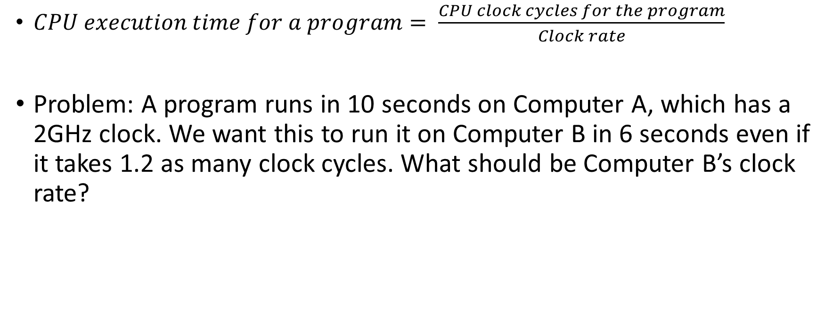
CPU Performance Calculation
$CPU execution time for a program= \frac{CPU clock cycles for the program}{Clock rate}$
Problem: A program runs in 10 seconds on Computer A, which has a 2GHz clock. We want this to run it on Computer B in 6 seconds even if it takes 1.2 as many clock cycles. What should be Computer B’s clock rate?

Slide 5
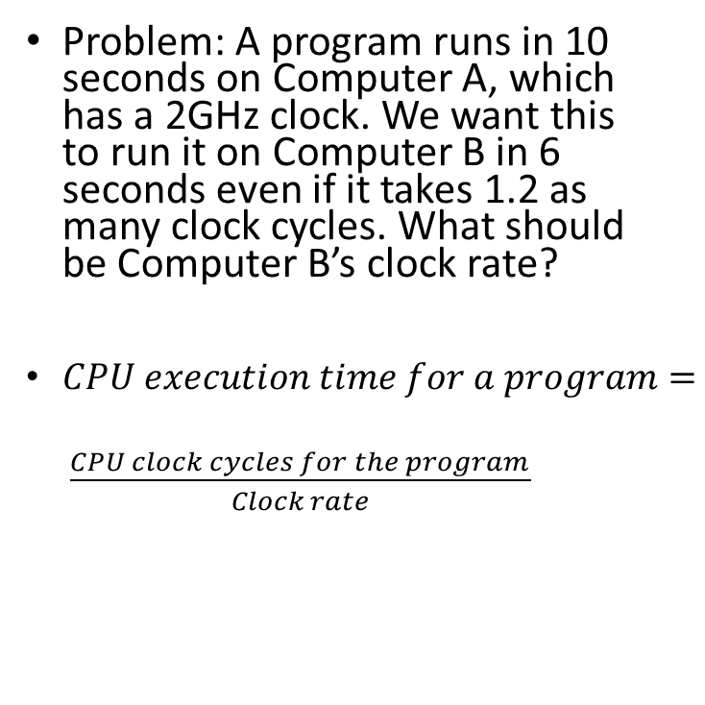
CPU Performance Calculation
Problem: A program runs in 10 seconds on Computer A, which has a 2GHz clock. We want this to run it on Computer B in 6 seconds even if it takes 1.2 as many clock cycles. What should be Computer B’s clock rate?
$CPU execution time for a program= \frac{\begin{aligned} \\ \\ CPU clock cycles for the program\end{aligned}}{Clock rate}$
Computer A
Clock rate = 2 GHz
Clock rate = 2 * 10⁹ cycles/second
Cycles = Clock rate * Time
Cycles = 2 x 10⁹ x 10 = 20 x 10⁹ cycles
Computer B
Cycles = 1.2 x Cycles for A = 1.2 x 20 x 10⁹ cycles
Cycles = 24 x 10⁹ cycles
Clock rate = Cycles / Time
Clock rate = 24 x 10⁹ / 6
Clock rate = 4 x 10⁹ cycles/second
Clock rate = 4 GHz

Slide 6
Computer History

Slide 7
Computer Organization Computer Architecture
Physical
Microarchitecture or Low level architecture
Programmer does not need to know how an addition operation is performed by the hardware
Deals with physical components
How to do (Implementation)
Logical
High-level architecture
Programmer has to be aware of the instructions that are used
Deals with logical components (instruction set, addressing mode, data types)
What to do (Instruction set)

Slide 8
Brief History of Computers
Generation | Time Period | Details
0th (Mechanical computers) | 1642-1945 | Mechanical devices (e.g. Difference Engine and Analytical Engine of Charles Babbage) – See next slide Konrad Zuse’s calculating machines using electric relays John Atanasoff’s calculator
1st (Vacuum tubes) | 1945-1955 | COLOSSUS in England (Alan Turing), ENIAC (Mauchley and Eckert)
2nd (Transistors) | 1955-1965 | Digital Equipment Corporation (DEC) PDP-1, CDC 6600, Cray Supercomputers
3rd (Integrated Circuits or ICs) | 1965-1980 | IBM System/360 series of computers – Same assembly language, multiple computers, introduced multiprogramming,
4th (Very Large Scale Integration or VLSI) | 1980-Ongoing | IBM and other ‘cloned’ Personal Computers (PC), Apple Macintosh, CP/M and DOS operating systems, Intel 80836 chip in 1985 (x86)
5th (Low power and invisible computers) | 1990s onwards | PDAs, Smart phones, IoT

Slide 9
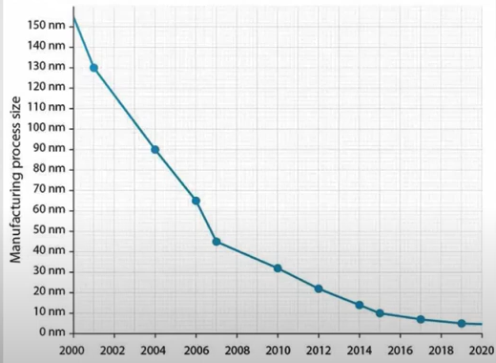
Reduction in Transistor Size

Slide 10
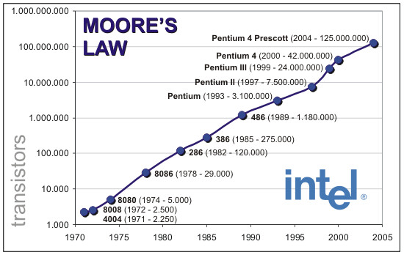
Computer Performance – Moore’s Law

Slide 11
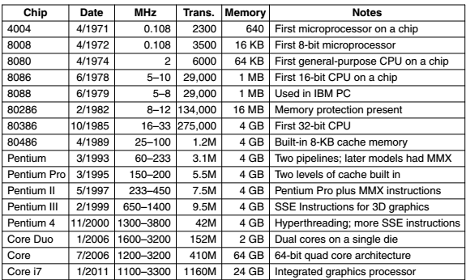
The Intel CPU Family

Slide 12
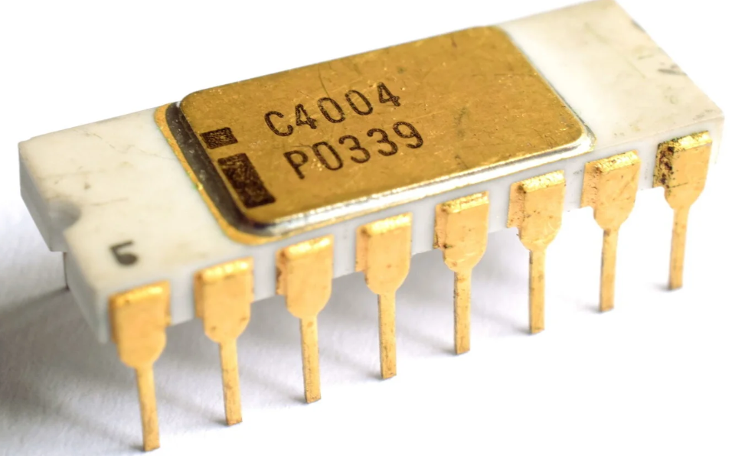
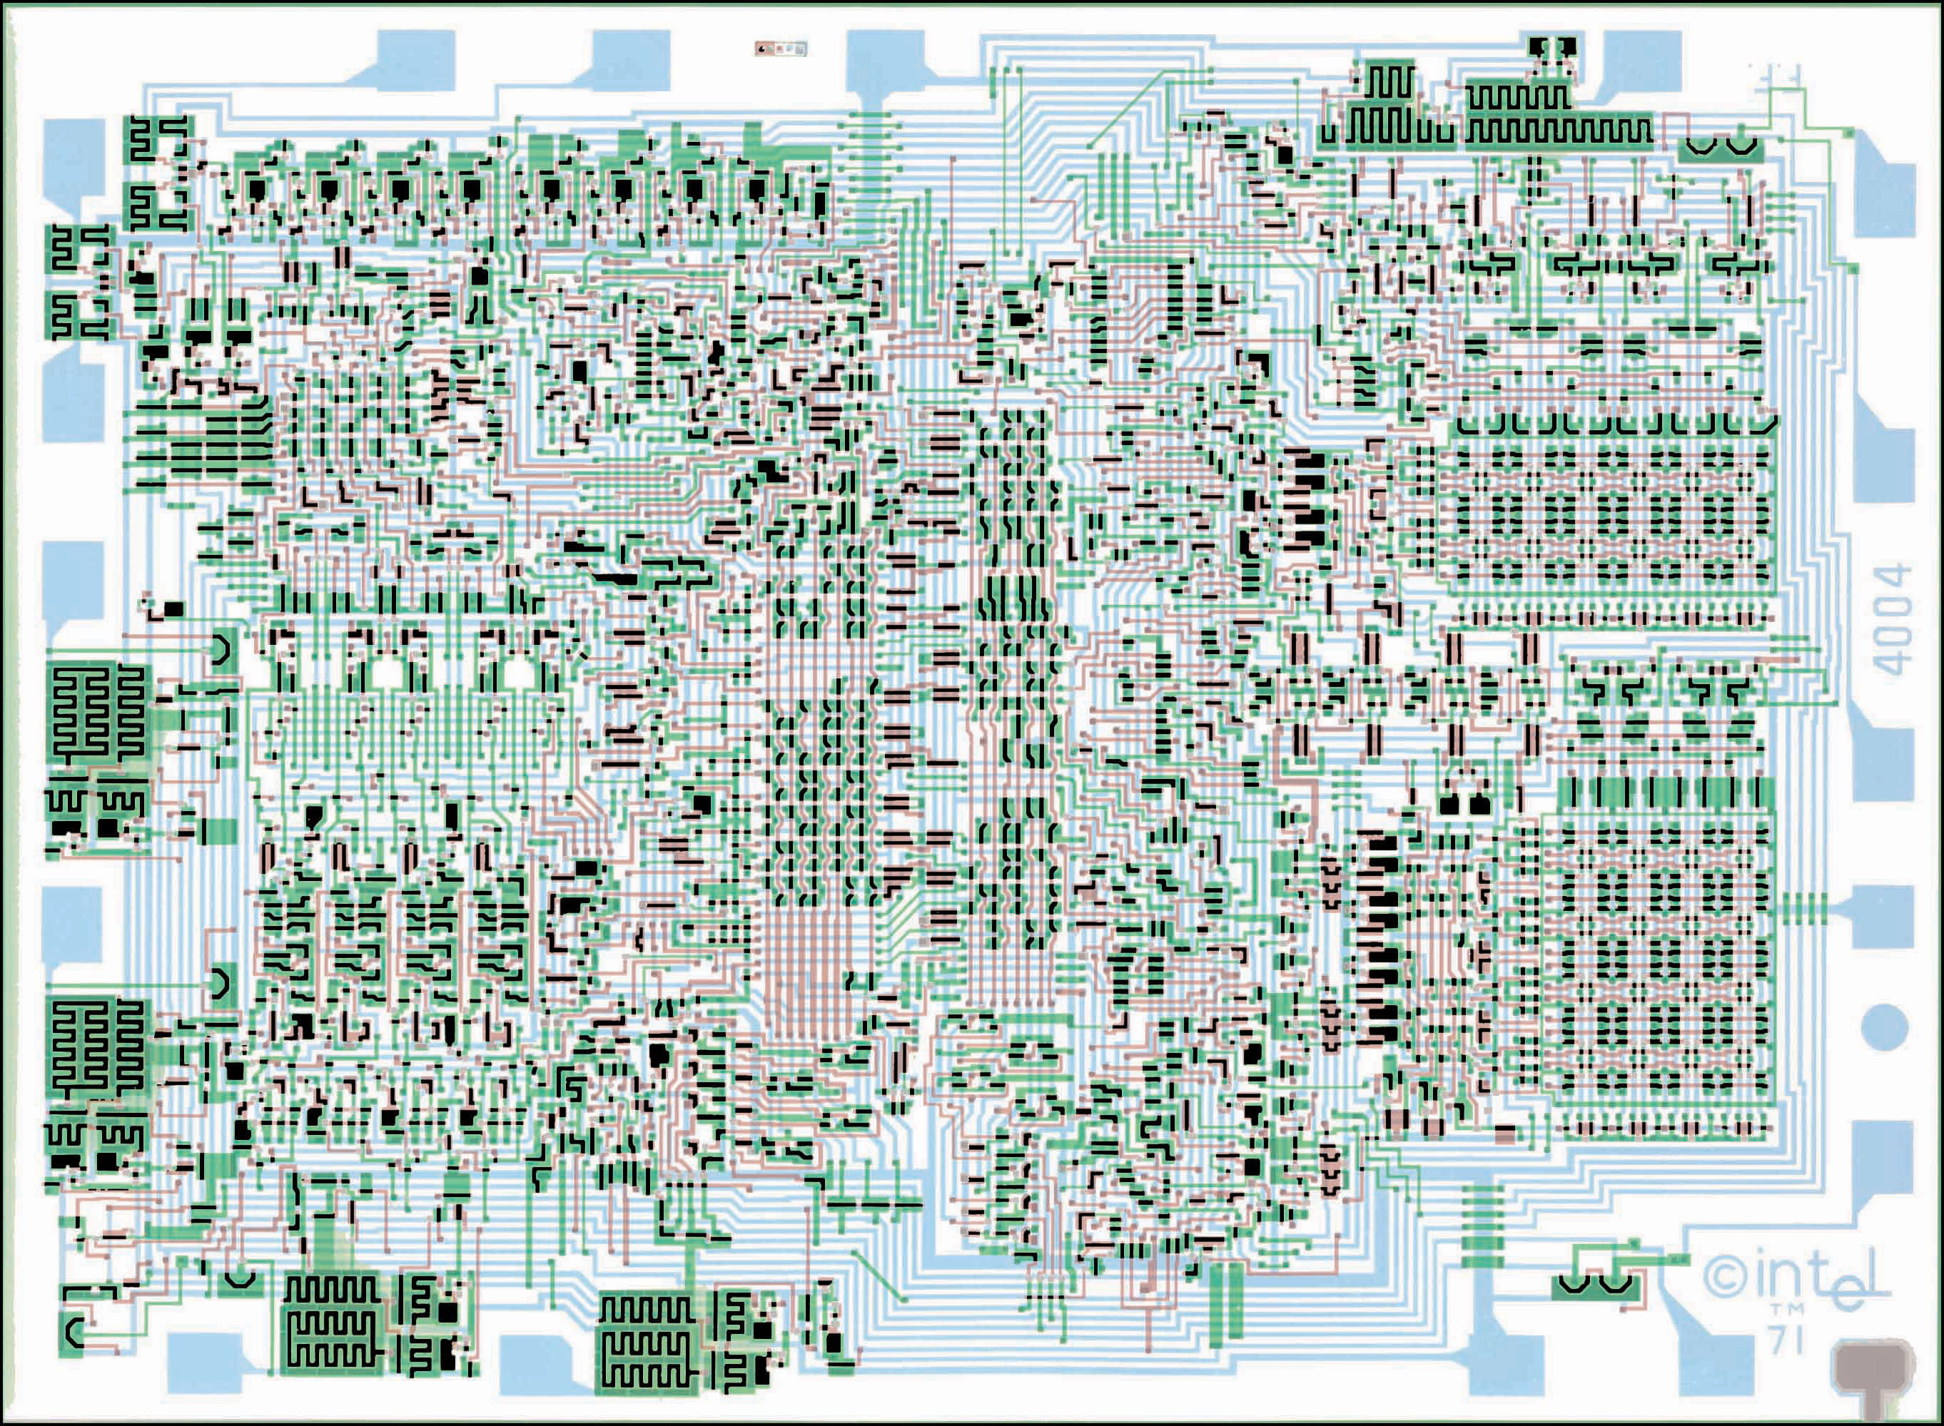
The 4004 Chip
Contained 2300 transistors

Slide 13
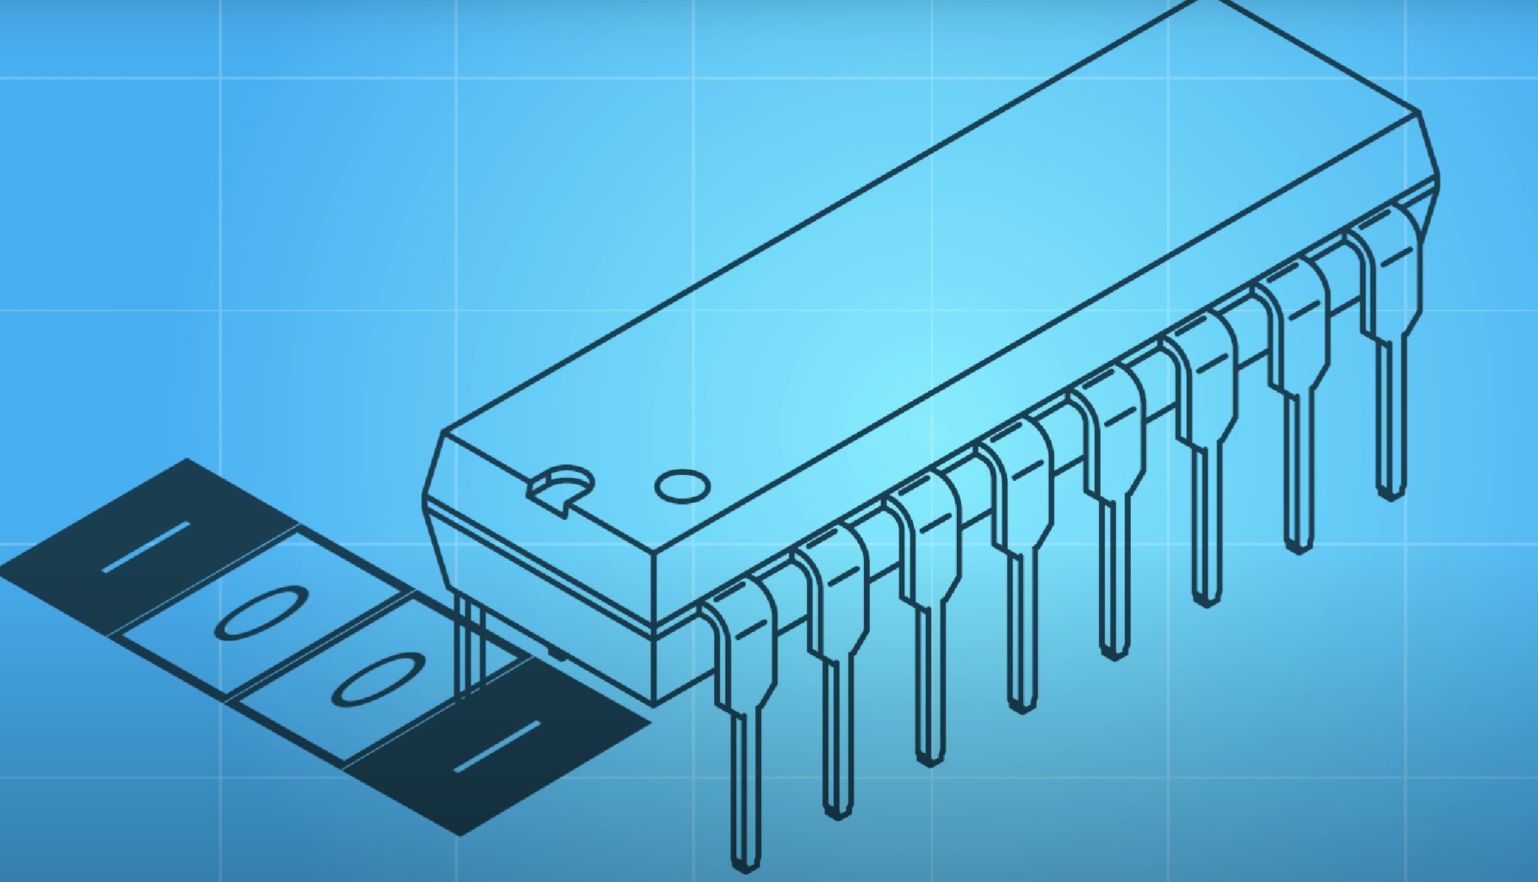
Instructions in 4004
Execution speed = 46,250-92,500 per second
ENIAC (The first computer) = 5,000 instructions per second
Fast forward to 2017: Intel Core i9 = 80 billion instructions per second
4-bit CPU (4 bits moved at a time)

Slide 14
Computer Hardware Operations
Consider an instruction ADD a, b, c
Meaning: a = b + c
Instructions are rigid
This instruction will perform only one operation
It must always have exactly three variables
What if we wanted to add b, c, d, e as a?
We will need three instructions
ADD a, b, c
ADD a, a, d
ADD a, a, e

